Slide 1
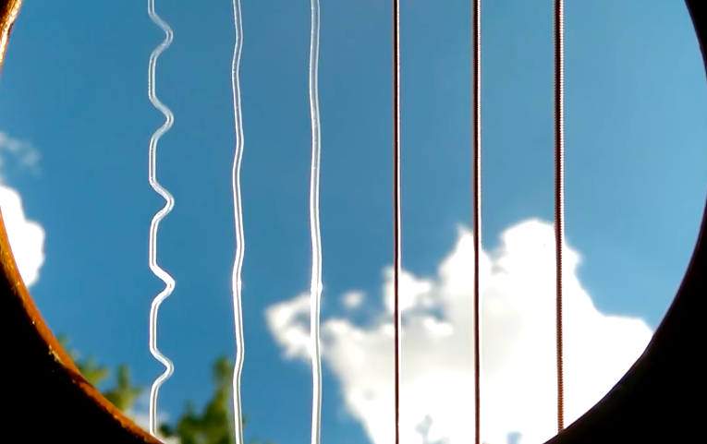
Problem No. 11 Guitar String
Ronald Dobos
12. Nov 2020
Unrelated but nice phenomenon
Links to the videos and quotes from the papers in notes $↓$
Notes:
https://www.youtube.com/watch?v=8YGQmV3NxMI

Slide 2
Problem statement
A periodic force is applied to a steel guitar string using an electromagnet. Investigate the motion of the guitar string around its resonance frequency
Arising questions:
Need to be steel and guitar string? Why so?
How exactly forced?
What can be interesting about a vibrating string??
Notes:
“Analysis of the motions of strings has motivated a surprising amount of science: From ancient Greeks investigating the length rations which produce harmonious sounds, to d’Alembert who developed the theory of partial differential equations in order to model the motions of a string.” - An experimental investigation into the dynamics of a string

Slide 3
Outline
Building intuition
Go through simpler cases
Review some basic theory
Understand its limitations
Finding the interesting part
Discuss setup
What has been done?
What you could do

Slide 4
Building intuition
Problem No. 11 Guitar string

Slide 5
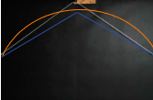
Initial disturbance
Notes:
https://www.youtube.com/watch?v=Qr_rxqwc1jE

Slide 6
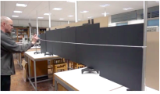
Initial disturbance
Notes:
https://www.youtube.com/watch?v=9O3VEXzuOKI

Slide 7
Initial disturbance
Notes:
https://www.youtube.com/watch?v=_X72on6CSL0

Slide 8
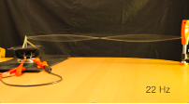
Periodic forcing
Remark: frequency has a great effect
Notes:
https://www.youtube.com/watch?v=cnH2ltfW48U

Slide 9
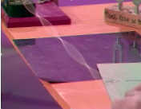
Periodic forcing
Remark: tension has a great effect
Notes:
https://www.youtube.com/watch?v=_aPl4Taroow

Slide 10
Basic theory
Problem No. 11 Guitar string

Slide 11
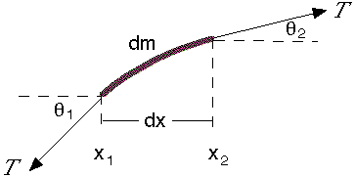
Basic theory
$F_{y}=Tsin\left(θ_{2}\right)−Tsin\left(θ_{1}\right)$
$F_{y}=T\left(\frac{dy\left(x_{2}\right)}{dx}−\frac{dy\left(x_{1}\right)}{dx}\right)=T\frac{d^{2}y}{{dx}^{2}}$
$F_{y}=dm\frac{d^{2}y}{dt^{2}}=μ dx\frac{d^{2}y}{dt^{2}}$
$$\frac{d^{2}y}{dt^{2}}=\frac{T}{μ}\frac{d^{2}y}{dx^{2}}$$
Notes:
Picture from:
https://www.animations.physics.unsw.edu.au/jw/wave_equation_speed.htm

Slide 12
Basic theory
$$\frac{d^{2}y}{dt^{2}}=\frac{T}{μ}\frac{d^{2}y}{dx^{2}}$$
With $\frac{T}{μ}=c^{2}$
wave equation, general solution?
$$y=Asin\left(k(x−ct)\right)+Bcos(k(x−ct))$$
$$y=F\left(x−ct\right)+G(x+ct)$$
Notes:
Picture from:
https://www.animations.physics.unsw.edu.au/jw/wave_equation_speed.htm

Slide 13
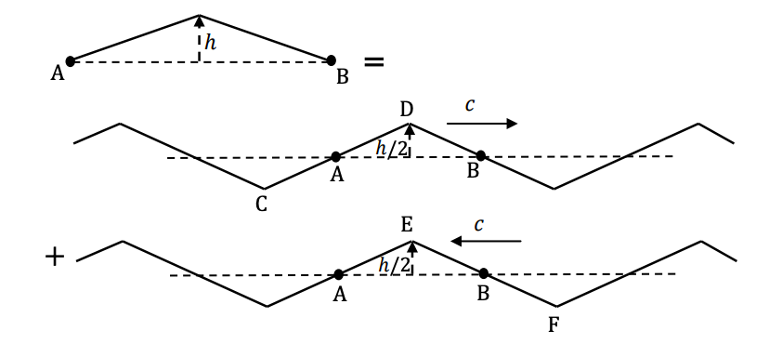
Basic theory
$$y=F\left(x−ct\right)+G(x+ct)$$
Notes:
https://www.youtube.com/watch?v=Qr_rxqwc1jE
Inspired by and picture from APHO 2010 Q1 (b):
https://www.ioc.ee/~kalda/ipho/2010%20APhO%20Theoretical%20Question%201_Question.pdf http://staff.ustc.edu.cn/~bjye/ye/APhO/2010S1.pdf

Slide 14
Basic theory
$$y=F\left(x−ct\right)+G(x+ct)$$
Notes:
https://www.youtube.com/watch?v=Qr_rxqwc1jE
Inspired by and pictures from APHO 2010 Q1 (b):
https://www.ioc.ee/~kalda/ipho/2010%20APhO%20Theoretical%20Question%201_Question.pdf http://staff.ustc.edu.cn/~bjye/ye/APhO/2010S1.pdf

Slide 15
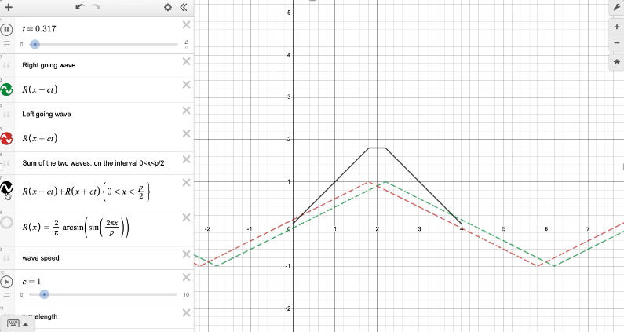
Basic theory
$$y=F\left(x−ct\right)+G(x+ct)$$
https://www.desmos.com/calculator/365anbv6mq
Notes:
Link to the Desmos interactive plot: https://www.desmos.com/calculator/365anbv6mq
Inspired by APHO 2010 Q1 (b):
https://www.ioc.ee/~kalda/ipho/2010%20APhO%20Theoretical%20Question%201_Question.pdf http://staff.ustc.edu.cn/~bjye/ye/APhO/2010S1.pdf

Slide 16
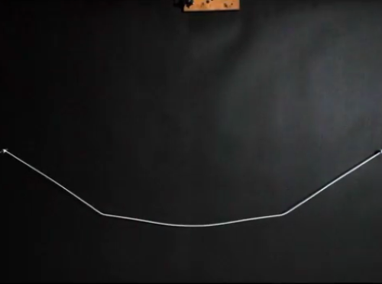
Basic Theory Limitations
Problem No. 11 Guitar string
Notes:
https://www.youtube.com/watch?v=Qr_rxqwc1jE

Slide 17
Limitation 1
$$y=F\left(x−ct\right)+G(x+ct)$$
Notes:
https://www.youtube.com/watch?v=Qr_rxqwc1jE

Slide 18
Limitation 1
$$y=F\left(x−ct\right)+G(x+ct)$$
Notes:
https://www.youtube.com/watch?v=Qr_rxqwc1jE

Slide 19
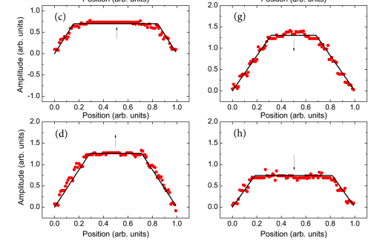
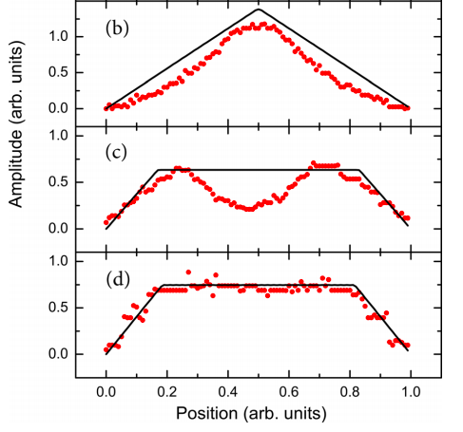
Limitation 1
Small amplitudes
Big amplitudes
S. B. Whitfield and K. B. Flesch, An experimental analysis of a vibrating guitar string using high-speed photography
doi: 10.1119/1.4832195

Slide 20
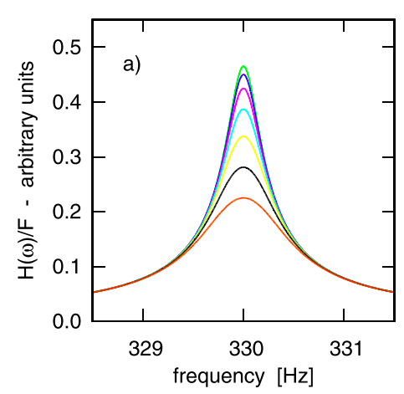
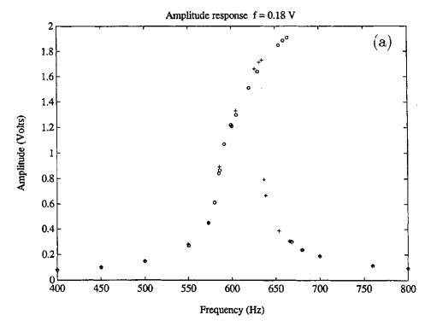
Limitation 2
$$\frac{d^{2}y}{dt^{2}}=\frac{T}{μ}\frac{d^{2}y}{dx^{2}}+F(x,t)$$
With $\frac{T}{μ}=c^{2}$
Considering an external periodic forcing $F(x,t)$
Expectation
Reality
M. Carla, Measurements on a guitar string as an example of a physical nonlinear driven oscillator. AJP (2017)
T. C. Molteno, An experimental investigation into the dynamics of a string. AJP (2004)

Slide 21
Basic theory
What went wrong?
… …
We assumed some things
Constant tension
Small amplitudes
Planar motion
Notes:
“While it is not difficult to satisfy this requirement when the string is executing free vibrations by merely limiting the initial displacement to sufficiently small values, it is inherently impossible to keep the tension from varying significantly when the string is set into forced vibration near any of its resonance frequencies” -

Slide 22
Past literature review
Problem No. 11 Guitar string

Slide 23
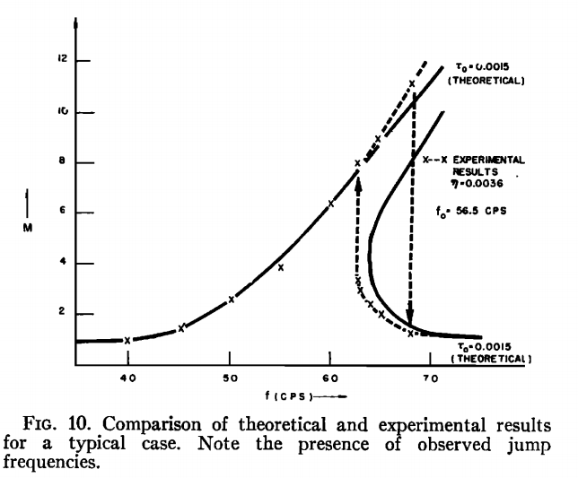
Oplinger 1960
“Modified wave equation for transverse motion”:
Accounts for tension changes
$$\frac{d^{2}y}{dt^{2}}=\frac{T_{0}}{μ}\frac{d^{2}y}{dx^{2}}+\frac{1}{2}\frac{EA}{μ}\left[\frac{1}{L}\int_{0}^{L}{{\left(\frac{dy}{dx}\right)}^{2}dx }\right]\frac{d^{2}y}{dx^{2}}$$
$$\frac{d^{2}y}{dt^{2}}=\frac{T}{μ}\frac{d^{2}y}{dx^{2}}$$
Oplinger, D. W. (1960). Frequency Response of a Nonlinear Stretched String. (1960) doi:10.1121/1.1907948

Slide 24
Oplinger 1960
“Modified wave equation for transverse motion”:
Accounts for tension changes
Only one transverse direction
$$\frac{d^{2}y}{dt^{2}}=\frac{T_{0}}{μ}\frac{d^{2}y}{dx^{2}}+\frac{1}{2}\frac{EA}{μ}\left[\frac{1}{L}\int_{0}^{L}{{\left(\frac{dy}{dx}\right)}^{2}dx }\right]\frac{d^{2}y}{dx^{2}}$$
Oplinger, D. W. (1960). Frequency Response of a Nonlinear Stretched String. (1960) doi:10.1121/1.1907948

Slide 25
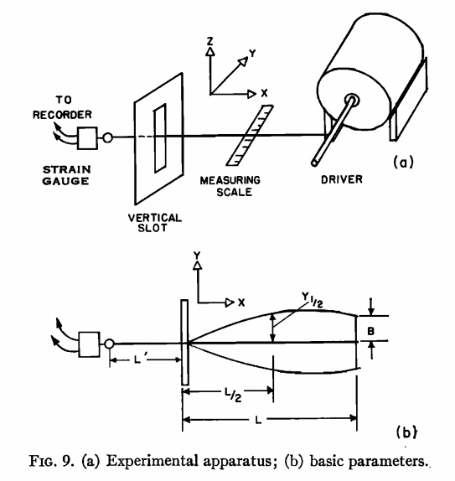
Oplinger 1960
”For these and other curves it was found convenient to write a program for a Bendix G-15 computer”
Oplinger, D. W. (1960). Frequency Response of a Nonlinear Stretched String. (1960) doi:10.1121/1.1907948
Notes:
Photo: https://en.wikipedia.org/wiki/Bendix_G-15

Slide 26
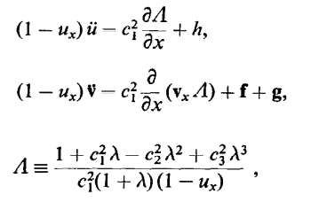
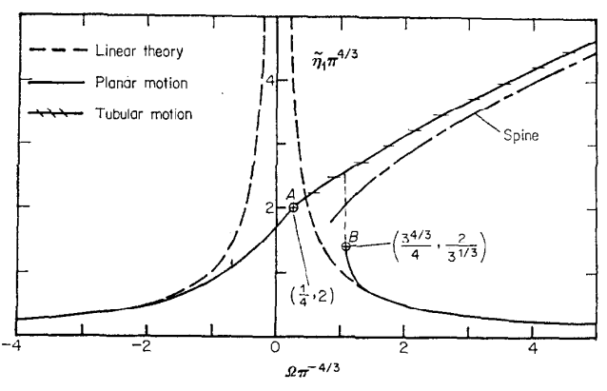
Narasimha 1968
Found the exact equations for 3D motion.
R. Narasimha, Non-linear vibration of an elastic string. J. Sound Vib (1968) 8 (1), 134-146
Notes:
“It is shown that it is neither necessary nor justifiable to assume that u is zero; and also that the velocity of propagation of u disturbances in a string is different from that in an infinite medium, although this difference is usually negligible.”

Slide 27
Narasimha 1968
Non-planar oscillations are parametrically excited by planar oscillations (found Mathieu eq.)
R. Narasimha, Non-linear vibration of an elastic string. J. Sound Vib (1968) 8 (1), 134-146
Notes:
Physically, the z motion is excited because of the variation of the tension in the string due to the y motion. The phenomenon is akin to so-called parametric resonance; in particular, the instability resembles that studied by Lubkin and Stoker [8] in a string, originally at rest, in which the tension is made to vary periodically (by some external means). In the present problem, the variation in tension is not imposed externally but is due to the oscillations in the y direction, and hence occurs in both space and time. The coupling between the two transverse modes is of a different kind, and arises from a variety of parametric resonance, planar motion being always unstable at sufficiently high amplitudes. A linear analysis of this stability shows that the critical amplitude at a given frequency is inversely proportional to the ratio of longitudinal to transverse wave speeds in the string. It falls to zero at the natural frequency and its subharmonics in the absence of damping, so that at all these frequencies a second transverse component may be expected. However, the presence of slight damping tends to suppress the second mode at the low subharmonics. It also raises the critical amplitudes and frequencies; non-linearity also has the same effect. Of course non-linearity has the further effect of limiting the z motion to a finite value.

Slide 28
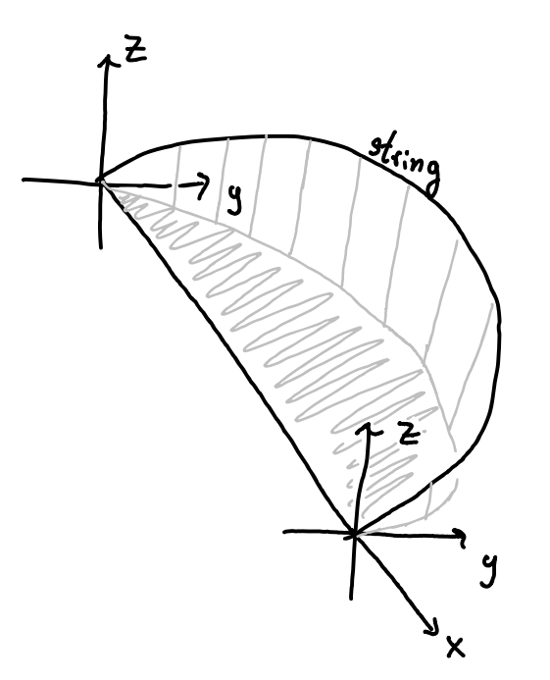
Elliot 1980
Free oscillations!
Go general, then approximate down.
Find energy in terms of the string shape:
$$\left(\begin{matrix}y(x,t) \\ z(x,t)\end{matrix}\right)=\sum_{j}{\left(\begin{matrix}V_{xj} \\ V_{yj}\end{matrix}\right)\sin\left(\frac{jπx}{L}\right)}$$
now plug into energy equation and obtain:
$F$ represents the first Fourier component of force
$$\ddot{Y}+ω^{2}Y\left[1+σ\left(Y^{2}+Z^{2}\right)\right]=0$$
$$\ddot{Z}+ω^{2}Z\left[1+σ\left(Y^{2}+Z^{2}\right)\right]=0$$
$ω=\frac{T_{0}}{2μL}$, $σ=\frac{3EA}{8T_{0}}$
J.A. Elliot, Intrinsic nonlinear effects in vibrating strings. Am. J. Phys. 48, 478 (1980)

Slide 29
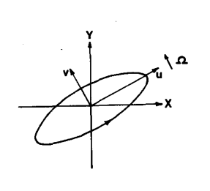
Elliot 1980
Free oscillations!
Taking limit of $Z≪Y$
Got Duffing eq. in Y solved (approx.) by:
Then in the other direction have:
$$\ddot{Y}+ω^{2}Y\left[1+σY^{2}\right]=0$$
$$\ddot{Z}+ω^{2}Z\left[1+σY^{2}\right]=0$$
$$y=acos⁡(pt)$$
$$p=ω(1+σa^{2}/2)$$
$$\ddot{Z}+ω^{2}Z\left[1+\frac{σa^{2}}{2}(1+cos⁡(2pt))\right]=0$$
J.A. Elliot, Intrinsic nonlinear effects in vibrating strings. Am. J. Phys. 48, 478 (1980)
Notes:
“A small initial transverse component b, in quadrature, causes a slight ellipticity of motion which then precesses, thus ultimately transferring the energy substantially from the initial X mode to the Y mode and then back again. The rate of precession is proportional to the area of the elliptical trajectory.”

Slide 30
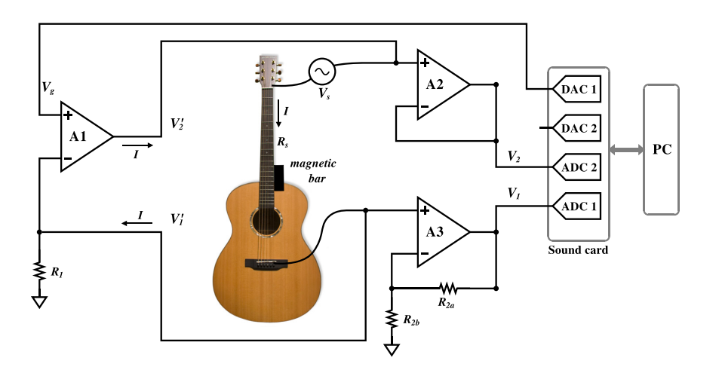
Carla 2017
M. Carla, Measurements on a guitar string as an example of a physical nonlinear driven oscillator. AJP (2017)

Slide 31
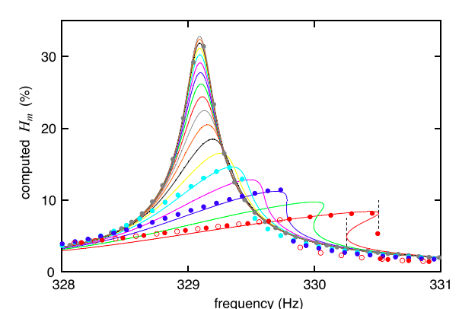
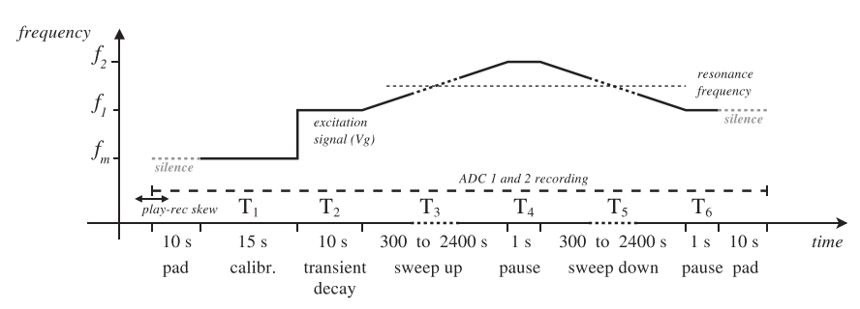
Carla 2017
Comparing experiments with the damped Duffing equation
$$\ddot{Y}+ωβ\dot{Y}+ω^{2}Y\left[1+σY^{2}\right]=0$$
M. Carla, Measurements on a guitar string as an example of a physical nonlinear driven oscillator. AJP (2017)

Slide 32
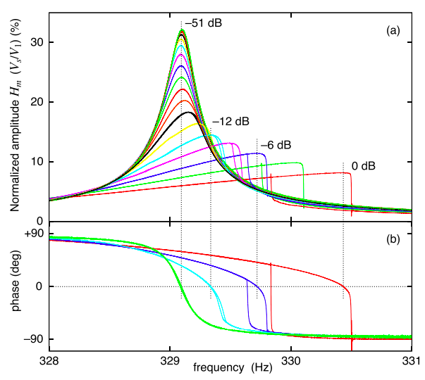
Carla 2017
M. Carla, Measurements on a guitar string as an example of a physical nonlinear driven oscillator. AJP (2017)

Slide 33
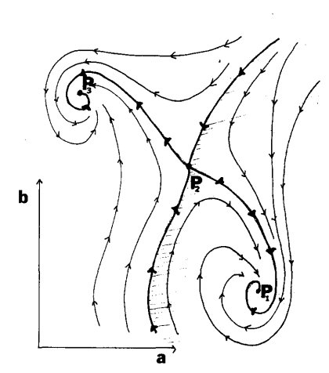
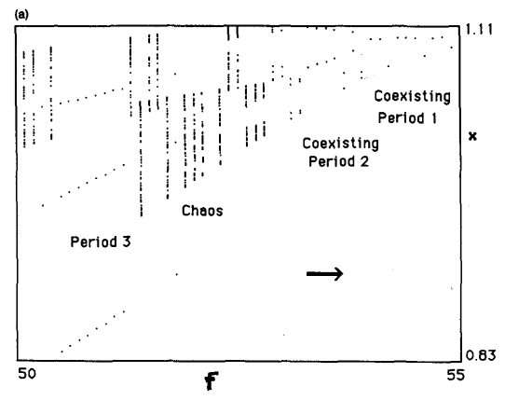
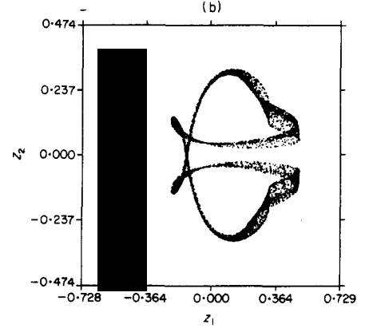
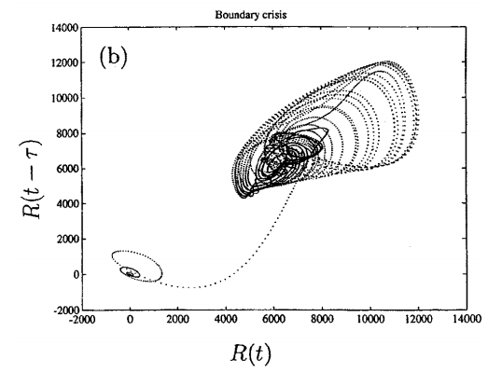
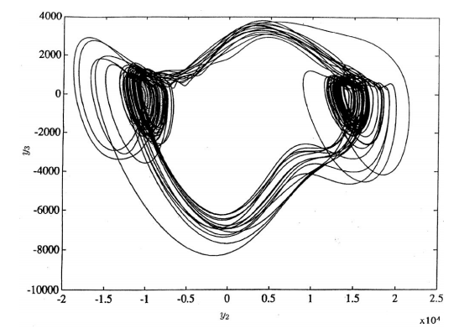
And a lot of chaos theory…

Slide 34
Setup
Problem No. 11 Guitar string

Slide 35
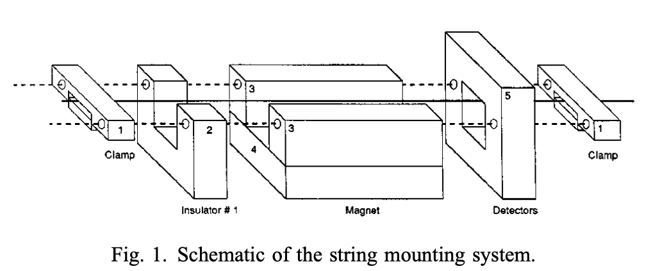
Setup - forcing
Most of modern literature uses alternating current in string + a magnet to force the string
How does this fit the pr. statement?
Use non-ferromagnetic wire for non-planar motions
Could also use ferromagnetic string and oscillating magnetic field from an electromagnet
A mechanical forcing should reproduce the effects (see ref.), but violates pr. statement (?)
T. C. Molteno N.B. Tufillaro, An experimental investigation into the dynamics of a string. doi: 10.1119/1.1764557

Slide 36
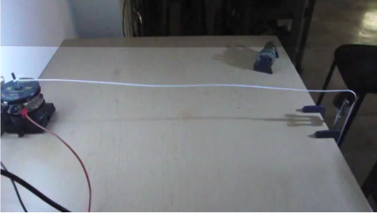
Setup – detection 1
Use stroboscope to “freeze vibrations”
Then capture with a camera
M. Carla, Measurements on a guitar string as an example of a physical nonlinear driven oscillator. AJP (2017)

Slide 37
Setup – detection 2
Either use very high-speed camera (slow motion),
or capture a large amount of photos with high shutter speed
then pick one with highest amplitude,
or take photos with slow enough shutter speeds
~ shutter speed (time) $≳$ 1/frequency of vibrations to capture a whole period
motion-blurred, but maxima visible
M. Carla, Measurements on a guitar string as an example of a physical nonlinear driven oscillator. AJP (2017)

Slide 38
Setup – detection 3
Accurate, but only measures amplitude in 1 t. direction
M. Carla, Measurements on a guitar string as an example of a physical nonlinear driven oscillator. AJP (2017)

Slide 39
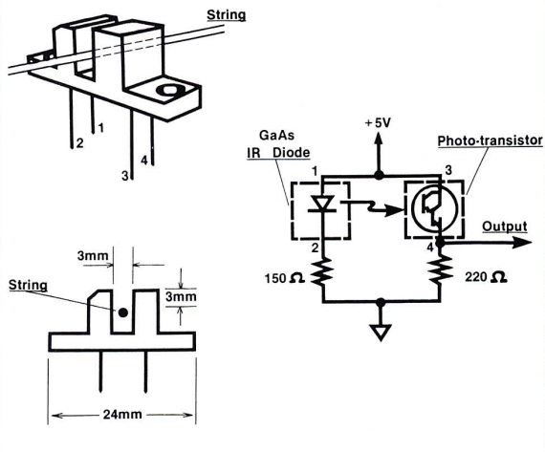
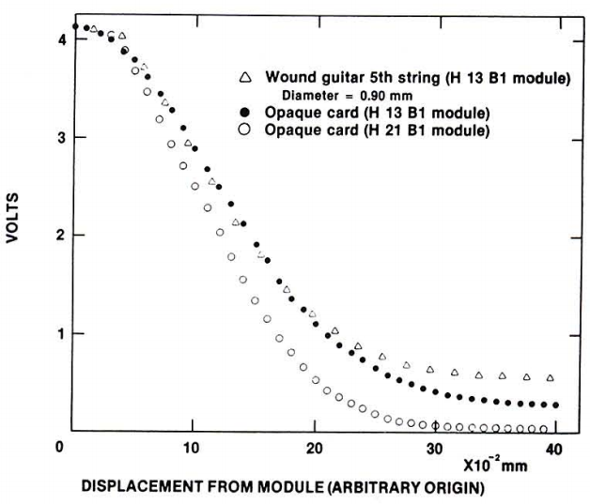
Setup – detection 4
can have 2 of these,
measure amplitude in both transverse
R. J. Hanson, Optoelectric Detection for String Vibration. The Physics Teacher (1987); doi: 10.1119/1.2342200

Slide 40
Conclusion What you should work on
Problem No. 11 Guitar string

Slide 41
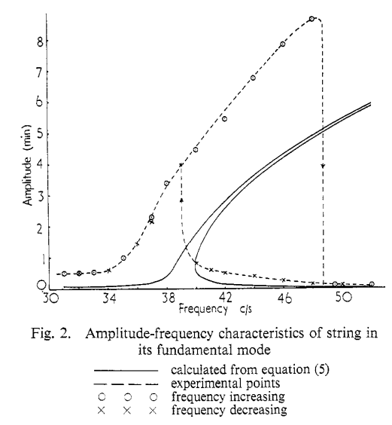
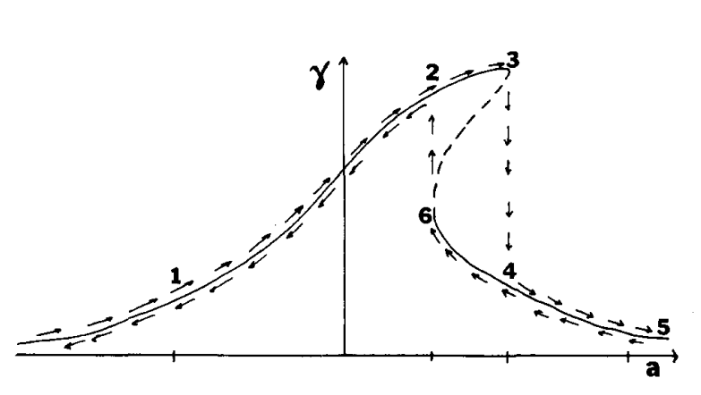
To measure: Duffing response curve
N. B. Tufillaro, Nonlinear and chaotic string vibrations. Am. J. Phys. 57, 408 (1989); doi: 10.1119/1.16011
E. W. Lee, Non-linear forced vibration of a stretched string. (1957) Br. J. Appl. Phys. 8 411

Slide 42
To measure: Non-planar instability
R. Narasimha Non-linear vibration of an elastic string. J. Sound Vib. (1968) 8 (1), 134-146
Notes:
When the amplitude of the string exceeds a certain critical value that depends upon the magnitude of the driving force, the string no longer vibrates in the plane of the force but begins to execute a whirling motion, tracing a tubular surface. When the jump in the amplitude takes place, the whirling stops and the motion becomes planar once again

Slide 43
To try: Non-harmonic forcing
Notes:
When the amplitude of the string exceeds a certain critical value that depends upon the magnitude of the driving force, the string no longer vibrates in the plane of the force but begins to execute a whirling motion, tracing a tubular surface. When the jump in the amplitude takes place, the whirling stops and the motion becomes planar once again

Slide 44
Chaos?
J.M. Johnson and A.K. Bajaj, Amplitude modulated and chaotic dynamics in resonant motion of strings. Journal of Sound and Vibration (1989) 128(1), 87- 107
N.B. Tufillaro, Nonlinear and chaotic string vibrations. Am. J. Phys. 57, 408 (1989); doi: 10.1119/1.16011
A.K. Bajaj and J.M. Johnson, On the amplitude dynamics and crisis in resonant motion of stretched strings (1991)
T.C. Molteno and N.B. Tufillaro, An experimental investigation into the dynamics of a string, Am. J. Phys. 72, 1157 (2004); doi: 10.1119/1.1764557
not much done experimentally….

Slide 45
Theory
Understand some of the basics from the literature
Compare different models to your experiments
Find new approximations
preferably easier but still working

Slide 46
References
STEM Fellowship
Sources of videos:
Brotherof
Dan Russel
Prof Miller
SMUPhysics
Pictures:
Theory
A video series about string simulation
Scientific papers cited in respective slides

Slide 47
Desmos waves superposition
https://www.desmos.com/calculator/365anbv6mq

